Slide 1
Team #5: SunView Software
Windows Application Thrashing Tool (WATT)
Joseph Caton, My Nguyen,
Brooks Olney, Thomas Pannozzo
Department of Computer Science and Engineering
University of South Florida
Tampa, FL 33620
Design Review for Senior Project
September 21, 2018

Slide 2
Acknowledgments
Tom Lumia from SunView and his team
Professor Giovannetti and his guidance
Design Review for Senior Project
September 21, 2018

Slide 3
Agenda
Background
Problem
Requirements
Design / Specification
Analysis
Project Plan
List of References
Design Review for Senior Project
September 21, 2018

Slide 4
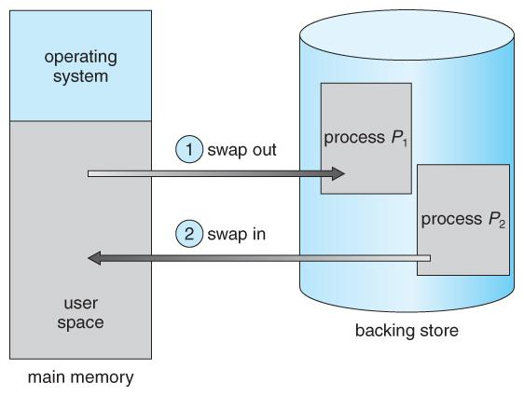
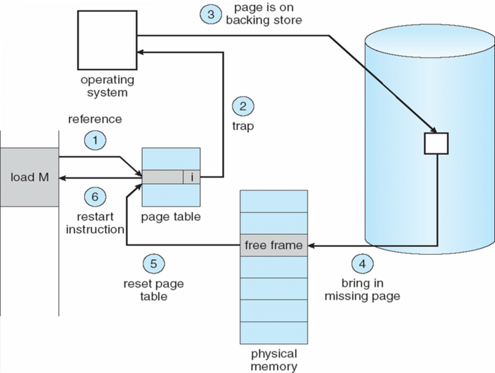
Background
Pertinent functionalities of operating system
Allocation of memory from programs
Paging and page fault
Memory swapping
Paging
Memory swapping
Design Review for Senior Project
September 21, 2018
Notes:
programs allocate memory from a virtual address space to the physical memory;
paging is the rapid exchange of data in memory for data on a hard disk;
page fault happens when a process is trying to access memory from RAM;
and memory swapping occurs when a page from RAM is swapped with a new page to be swapped back to RAM.
Swapping refers to copying the entire process address space, or at any rate, the non-shareable-text data segment, out to the swap device, or back, in one go (typically disk). Whereas paging refers to copying in/out one or more pages of the address space.

Slide 5
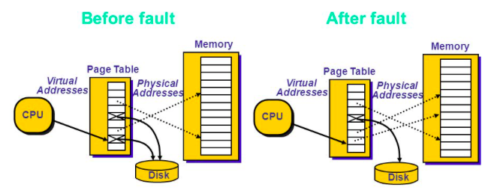
Background
Thrashing, or disk thrashing, occurs when there is high paging activity, meaning a process is spending more time paging then executing.
Design Review for Senior Project
September 21, 2018

Slide 6
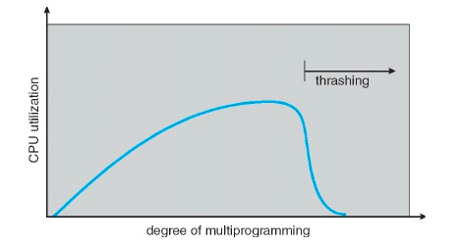
Background
Causes of thrashing:
under allocation of minimum number of pages required by process
CPU scheduler sees decreasing CPU utilization and increases the degree of multiprogramming
Design Review for Senior Project
September 21, 2018
Notes:
If a process does not have “enough” pages, the page-fault rate is very high. This leads to:
low CPU utilization
operating system thinks that it needs to increase the degree of multiprogramming because of low cpu utilization
another process added to the system
Thrashing ≡ a process is busy swapping pages in and out

Slide 7
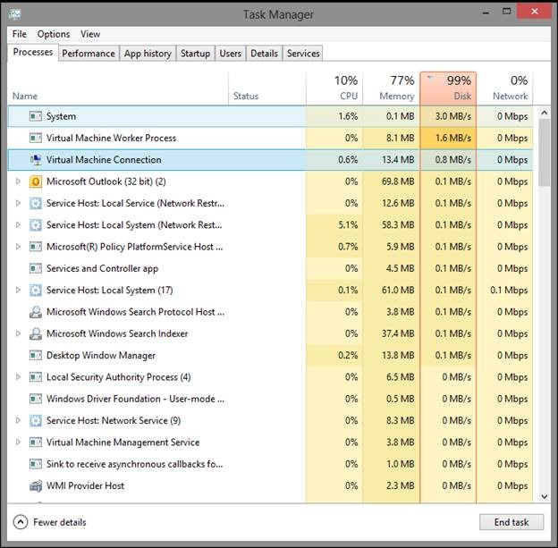
Background
Characteristics of thrashing include but not limited to:
high page faults
high memory usage
low CPU utilization
non-responding applications or processes
Design Review for Senior Project
September 21, 2018

Slide 8

Problem
SunView Software is the leading provider of IT Service Management, Change Management, and Service Desk ticketing solutions.
The problem addressed by the requirements is, “When is the Windows OS thrashing and how can a detection tool be created to give an alert when thrashing occurs?”
Design Review for Senior Project
September 21, 2018
Notes:
Sunview presented this as a situation where the customer would reach out to them about their services not responding. Upon inspection by a system administrator, they see that the system is locked up and not responding (i.e, thrashing). They reboot the computer and all is well. How can we eliminate some steps here and alert the administrator when it is occurring or about to occur? And, is there the possibility to solve this problem autonomously?

Slide 9
Requirements
(Developer) Capture pagefile activity
(Developer) Capture system’s memory usage
(Developer) Capture CPU usage
(Developer) Measure the rate of change for the ready queue
(Developer) Measure the rate of change for page faults
(Developer) Package these statistics in an organized manner
(Developer) Force thrashing on virtual machine
(Developer) Smart detection using machine learning
(IT System Admin) Know when one of my systems is thrashing
(Developer) Limit the possibility of false positives
Design Review for Senior Project
September 21, 2018
Notes:
this is our user stories
our general acceptance criteria is to have a successful application

Slide 10
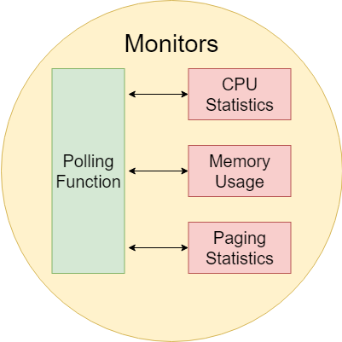
Design / Specification
Algorithm written in C#
Utilize .NET system calls for process/memory information
Data Gathering
System resource monitors
Polling function for periodic data capture (averaging)
Design Review for Senior Project
September 21, 2018

Slide 11
Design / Specification
Induce Thrashing
System resource monitors
Polling function for periodic data capture (averaging)
Develop Machine Learning Algorithm with PyTorch for Detector
Develop Comparator for Detector and Polling Monitors
Bonus feature is to identify which process is causing the thrashing
Design Review for Senior Project
September 21, 2018
Notes:
--We’re going to create a VM (Windows Server) with intentionally low resources, then generate resource demanding programs on it to force thrashing. These trashing instances will give us training data for our machine learning model. We can collect trends on the number of page faults in the system, the ready queue, and CPU/Memory usage to plug into our model. This algorithm will be used using Python’s PyTorch library.

Slide 12
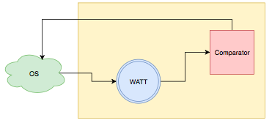
Design / Specification
Machine Learning Statistics or “Features”
(Action) Measure rate of change for
Ready queue decreasing
Page faults increasing
(Symptom) Compare detected rate of change with
Low CPU utilization
High memory usage
Design Review for Senior Project
September 21, 2018
Notes:
Features in ML are input variables used for making predictions. When thrashing occurs, it’s usually caused by the ready queue decreasing while page faults increase. The rate of change of these features

Slide 13
Analysis
A commercial product is not available to detect thrashing at the moment
Machine learning provides a dynamic solution
Provides adaptability to changing environments
PyTorch is open source
No additional cost per unit software
Reduce overhead in the following areas:
Man hours
Hardware
Money
Design Review for Senior Project
September 21, 2018

Slide 14
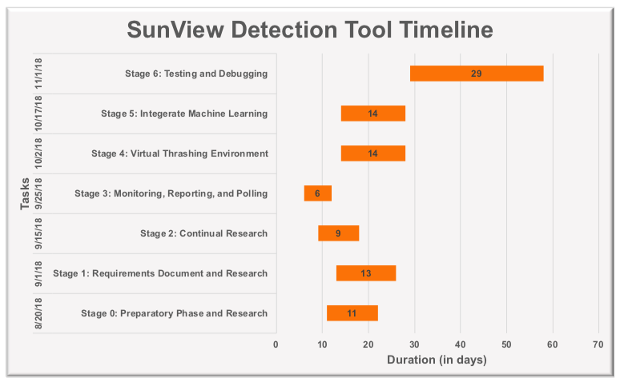
Project Plan
Design Review for Senior Project
September 21, 2018

Slide 15
List of References
What is thrashing in an operating system?, Quora, 2018. URL:https://www.quora.com/What-is-thrashing-in-an-operating-system.
Thrashing (computer science), Wikipedia, 2018. URL: https://en.wikipedia.org/wiki/Thrashing_(computer_science).
Thrashing, Techopedia, 2018. URL: https://www.techopedia.com/definition/4766/thrashing
Thrashing, Computer Hope, 2017. URL: https://www.computerhope.com/jargon/t/thrash.htm.
Images are from www.google.com
Design Review for Senior Project
September 21, 2018

